Slide 1
Introduction to Kubernetes: Containers Orchestrator
TechSpark
The IAEA Tech Talks
Rina Ahmed
Casimir Compaore
SGIS – Safeguards – IAEA

Slide 2
Agenda
Containers
Kubernetes
CI/CD with K8s
Canary Deployment
Serverless
What Next?

Slide 3
Keywords on us ☺
Casimir
Rina
SGIS TechLead
Kubernetes Whisperer
Soccer
SGIS TechLead
Technical Evangelist
Philosophy

Slide 4
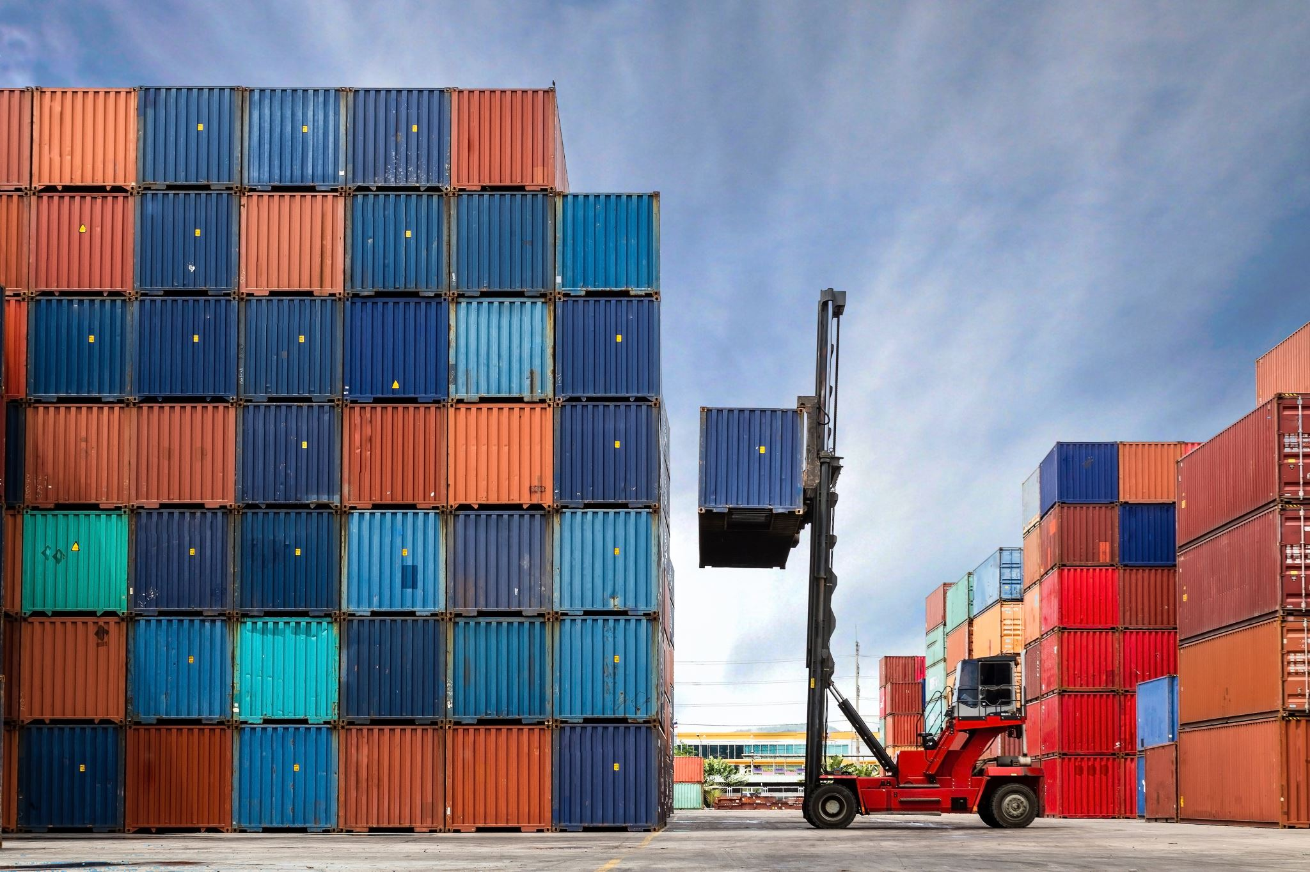
Docker is a framework to containerize applications
Kubernetes is an orchestration platform that manages all the containers running on your infrastructure

Slide 5
Containers
App decoupled from OS
App packaged with its dependencies
Immutable: app container does not change in Production
Container
Container
Container
App
App
App
Bin, Lib
Bin, Lib
Bin, Lib
Container Engine
Host OS
Server

Slide 6
Containers
Build images
Push into image registry
Run container
Security, vulnerability scanning

Slide 7
Docker
Kubernetes runs a different container engine but supports Open Container Initiative (OCI) standard
Docker supports OCI
Demo

Slide 8
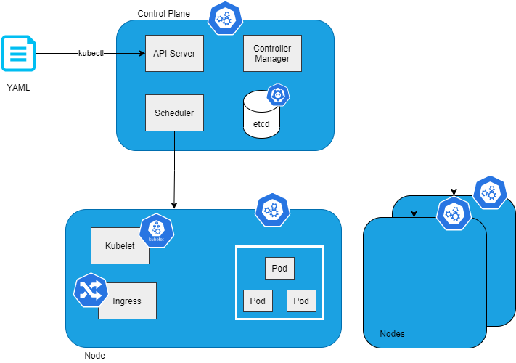
Kubernetes

Slide 9
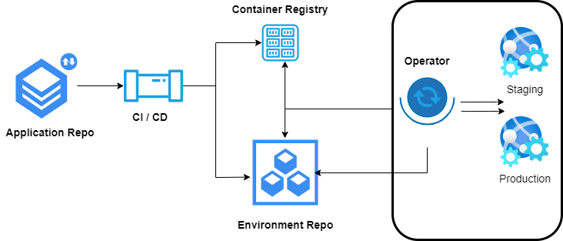
GitOps
Describe Application/Environment as Code in a Git repository
Trigger CI/CD for Desired State and continuously sync

Slide 10
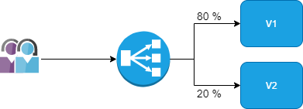
Canary Deployment
Have multiple version of containerized applications
Split traffic to route to both versions according to rules
Preview features in advance

Slide 11
Serverless
Serverless programming model with Kubernetes
[Serverless Kubernetes]
Do not manage the cluster
Hosted Container Instances
We are not talking about this today. ☺
Function
Function as a Service
Containerize
Containerize functions and run on K8s
Event
Event-Driven
Scale
Scale on Kubernetes by events (rather than CPU, memory, …)

Slide 12
You saw today …
Application Containers (Docker)
Kubernetes architecture
Applying GitOps
Canary Deployment
Serverless on Kubernetes

Slide 13
What Next?
Security
Networking
Storage-Volumes
Chaos Engineering
Service Mesh
Multi-Tenancy
Observability
Extensions
Platforms

